Slide 1
Unusual Event Detection from
surveillance video shots
Organisation: Department of Science and Technology
College: National Institute of Technology, Warangal

Slide 2
About the Team
Dilisha Jain Kala (Team Leader) - Final Year B.Tech (CSE)
Himadyuti Bhanja - Final Year B.Tech (CSE)
Samarjit Karmakar - Final Year B.Tech (CSE)
Pratham Tangri - Final Year B.Tech (CSE)
Anirban Panda - Final Year B.Tech (EEE)
Aabhaas Dasgupta - Final Year B.Tech (CSE)

Slide 3
Problem Statement Description
The problem is aiming at detecting unusual events from surveillance videos. All the videos are shot using a single static camera. One example of such an event could be detection of events where a car is having an accident.
Input: Videos shot using static camera with one event per shot.
Expected Output: Automatically detect the unusual activity. Give the start and end time of the event

Slide 4
Possible Use Cases
Road accidents -
Car Crashes
Pedestrian Accidents
Sudden Stopping, and so on...
Traﬃc rules violations
Lane crossing
Traﬃc light violation
Overspeeding
Wrong lanes
Thefts (in ATMs/banks/homes)

Slide 5
However, accident detection systems are common ….
RIGHT?
Lets see the existing solutions once

Slide 6
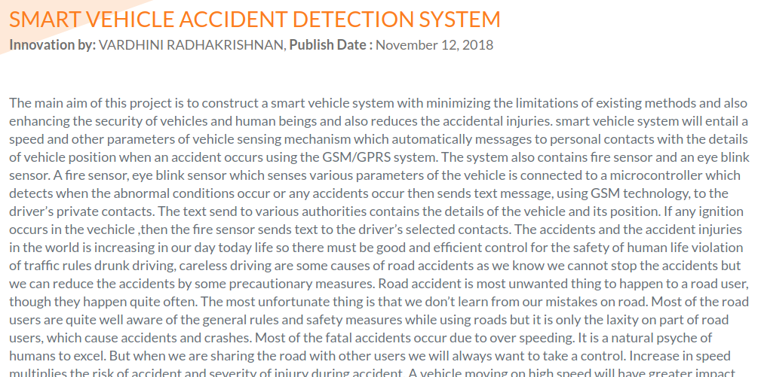
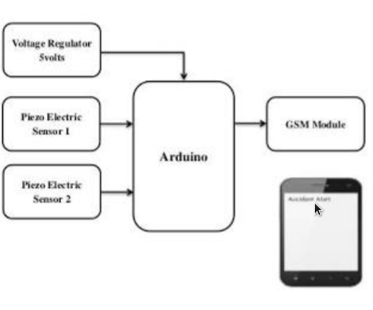

Slide 7
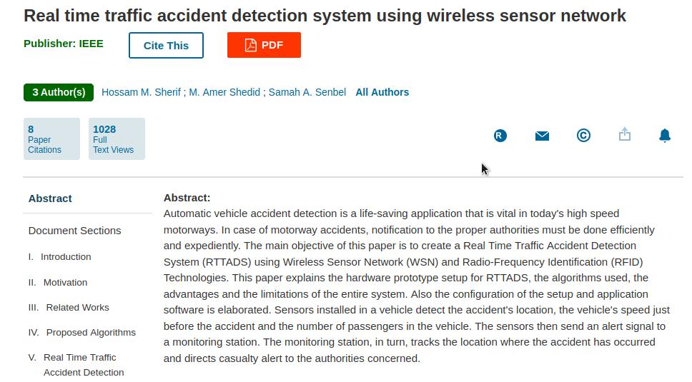

Slide 8
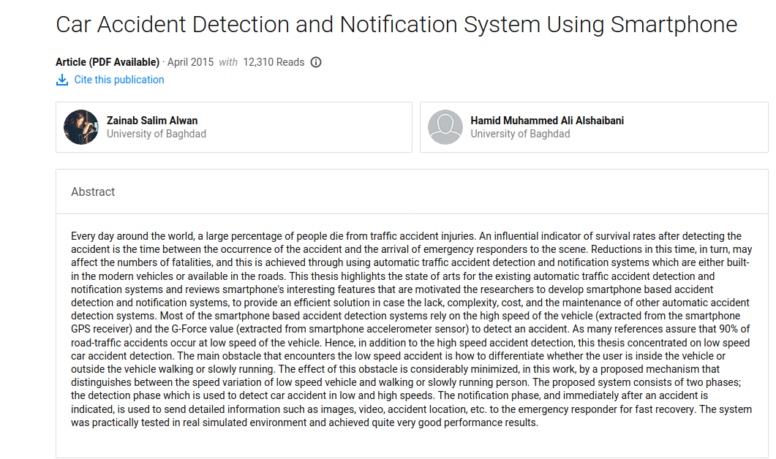

Slide 9
All are good solutions, but what is common?
HIGH EMPHASIS ON HARDWARE(BE IT ARDUINO OR WIRELESS SENSOR NETWORKS OR PHONE ACCELEROMETERS)

Slide 10
But what is the problem?
Too much emphasis on hardware equates to issues of cost and scalability.
More components of the system, more chance of failure and time consumption.
Can’t leverage the advances being made in AI

Slide 11
So, what do we do?
Minimise use of hardware as much as possible.
Software based solution ensures massive scalability.
Use the best performing models in Deep Learning to get maximum leverage in terms of latency and accuracy.
Build a web-based interface which requires minimal user intervention for easier deployment.

Slide 12
Our Proposed Solution
We plan to build a Deep Learning based Intelligent web-app that would detect unusual traﬃc events in real time using feed from various surveillance cameras or dashcams, and then send an alert to the concerned authorities to notify the exact timing and place of occurrence of the event.
Our alert system will also send an alert to the nearest hospital for timely action in the form of ambulance/medical facility.

Slide 13
What’s new in it?
Usage of 3D CNN model in Video Surveillance (usually done by using a mathematical averaging of images in the video).
A graphical description of the event span with a measure of the event occurrence in each time unit.
Fine grain of features are learnt for videos using a single architecture which uses the both spatial (w and h) as well as temporal (t) characteristics leading to lower latency and higher accuracy.

Slide 14




Project Milestones
Integrating with the Web app
Connecting the ML model to the web app,testing out uploaded videos .
Initiation
Fixing the problem
Experimenting with different models
Trying various models including 3D CNN, LSTM in NVIDIA 1070 TI GPU.
statement, deciding on the architecture, setting up the
environment.
Future Work
Adding Maps API for proximity searches, adding support for more events, real-time hardware integration.
Pre-processing
Selection of dataset, pre-processing, data cleaning, framing, etc.
Testing Accuracy
Testing the model for various video samples & check accuracy.

Slide 15









Technology Stack
Machine Learning
Web Development

Slide 16
Input Video
Break into frames
Flow chart for the detection
Pass through model
Detect Unusual Events

Slide 17
Deep Learning Pipeline
Dataset of videos of unusual events, with start and end times demarcated
Input
Data Preprocessing by dividing into various frames of ﬁxed size
Train on a 3D CNN Deep Learning Model
Prepare
Train
Evaluate
Model Evaluation Based on Classiﬁcation Accuracy and Loss values

Slide 18
Deep Learning Model used
3D CNN
CNN (Convolutional Neural Network) is a class of deep neural networks, which can be used in conjunction with a deep learning platform. A CNN is a network of processing layers used to reduce an image to its key spatial features so that it can be more easily classiﬁed. The advantage of CNNs over other uses of classiﬁcation algorithms is the ability to learn key characteristics on their own, reducing the need for hyperparameters, hand-engineered ﬁlters. These algorithms are increasingly being used for tasks such as facial recognition, image classiﬁcation, video analysis, and automatic caption generation.

Slide 19
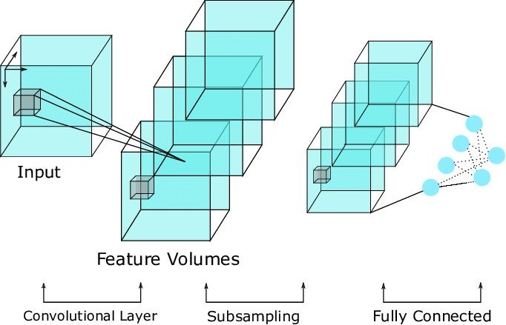
3D convolutions applies a 3 dimensional ﬁlter to the dataset and the ﬁlter moves 3-direction (x, y, z) to calculate the low level feature representations. Their output shape is a 3 dimensional volume space such as cube or cuboid. They are helpful in event detection in videos, 3D medical images etc.

Slide 20
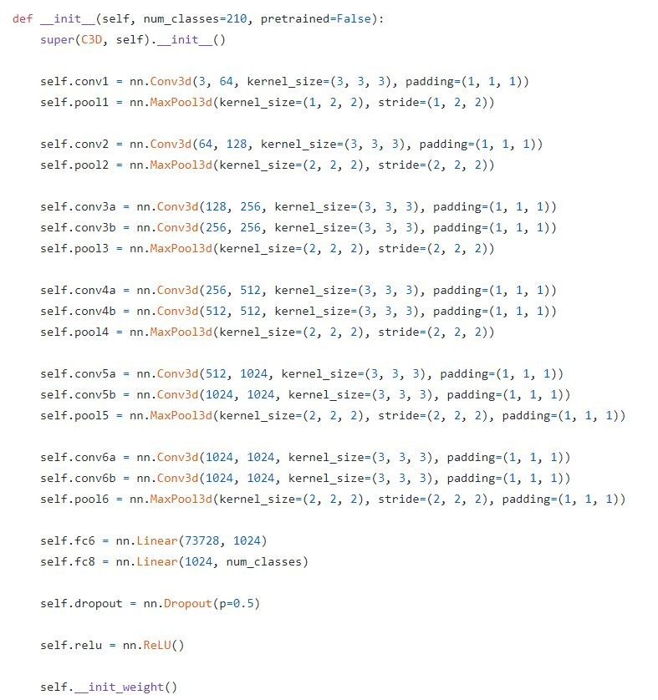
Model Architecture

Slide 21
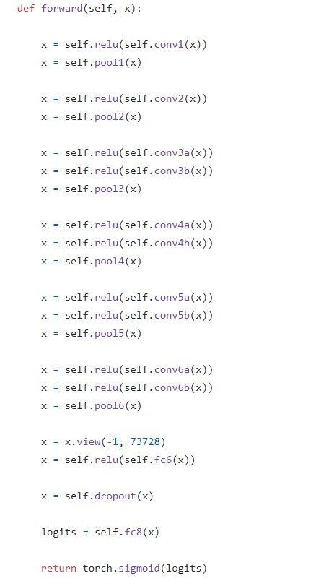

Slide 22
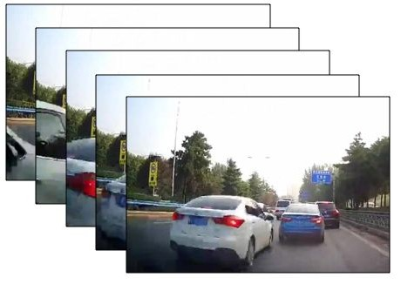
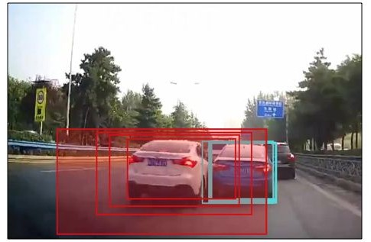
Description of Dataset
We have used A3D dataset in this case. The A3D dataset contains 1300 video samples from YouTube and a ﬁle including human annotated video start/ end time and anomaly start/end time.

Slide 23
Experimental Details
After preprocessing, the samples were fed into the 3D-CNN model. Learning rate was kept ﬁxed at 0.01. The frame size was kept as 210 after padding. The model was trained in NVIDIA 1070 TI GPU.
We took the XNOR operation between the original video sample and the produced output of the 3D-CNN, keeping threshold value as 0.75.

Slide 24

Sample Result

Slide 25
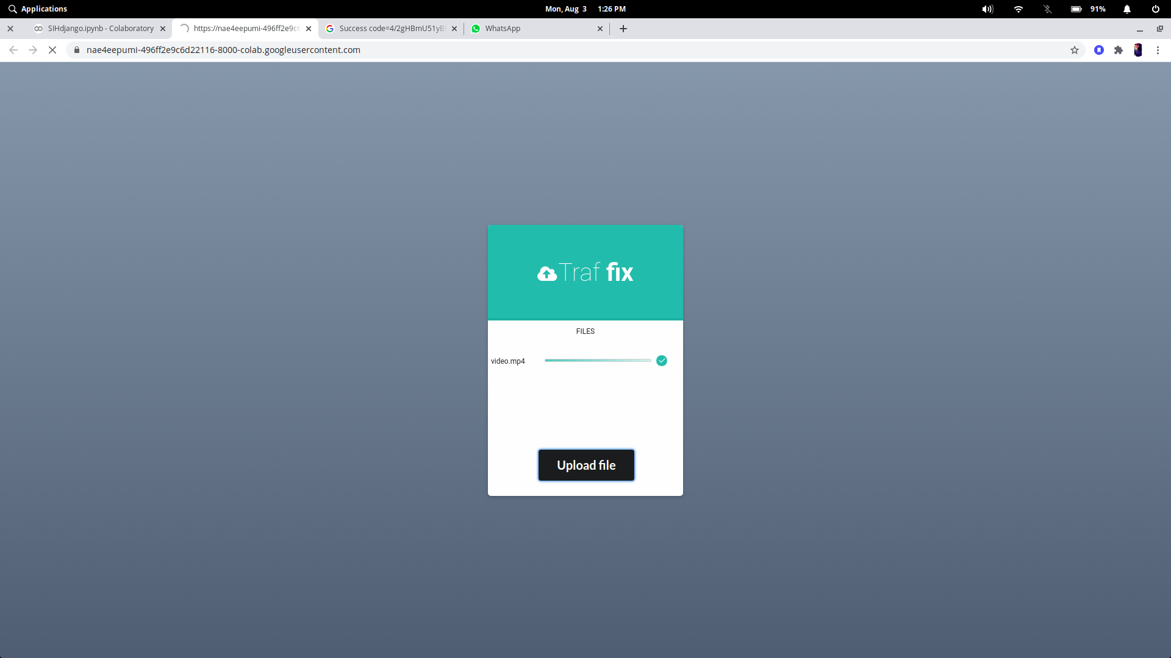

Slide 26
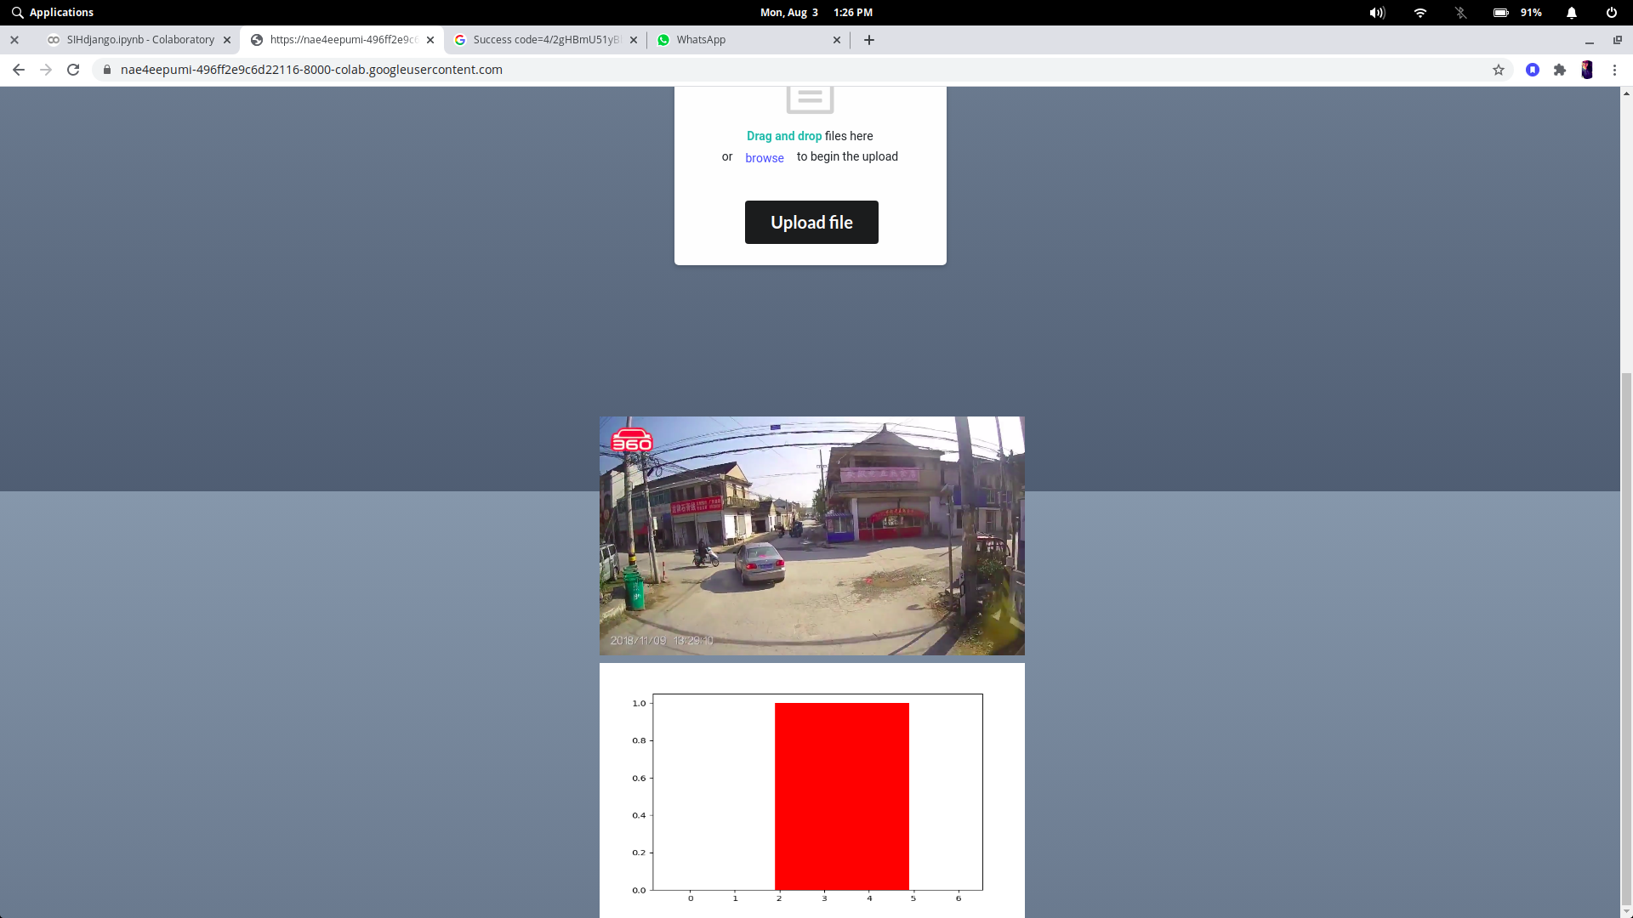

Slide 27
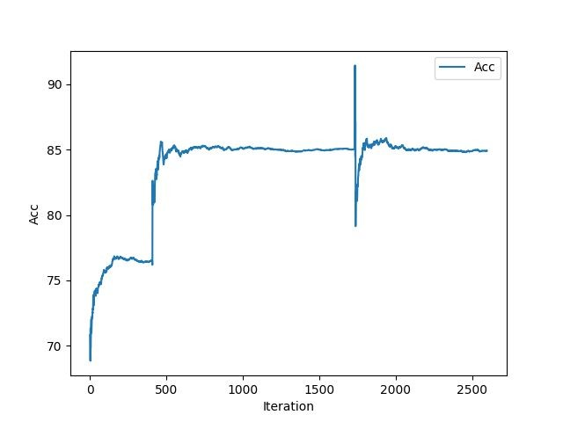
Accuracy Chart

Slide 28
Bottlenecks and current issues
Long computational time
Our experiments have shown that running one epoch of 3D CNN takes approximately 4 hours for 1300 samples on the available GPU. This is creating a hinderance for us.
A solution can be using multiple GPUs in parallel, which can dramatically speed up the computation.

Slide 29
Inability to add locational services
Currently the “local search APIs” are mostly paid or unavailable to use in India. Thus we aren’t able to add these features to make our solution more useful

Slide 30
Scaling & Feasibility
Being a simple web app, it is easy to apply in any surveillance system, all you need to do is upload the video from a single static camera and check the time duration for the accidents.
However, problems may arise in various cases, where we have a low resolution video or noisy sample (videos shot in rain), in that case the model needs to be more robust to correctly predict the unusual activities.
All the software used till now have been Open-Source, thus incurring no extra cost.

Slide 31
Future Plan of Action
Adding Locational Services to contact the nearest hospital and police station.
Adding support for other types of unusual events(like traﬃc signal violation, theft detection).
Adding real-time video detection facility(by integrating with hardware).
Training with more advanced Machine Learning models for further improved accuracy.
Adding improved GUI features based on consumer suggestions.
Trying for different types of resolutions for videos

Slide 32
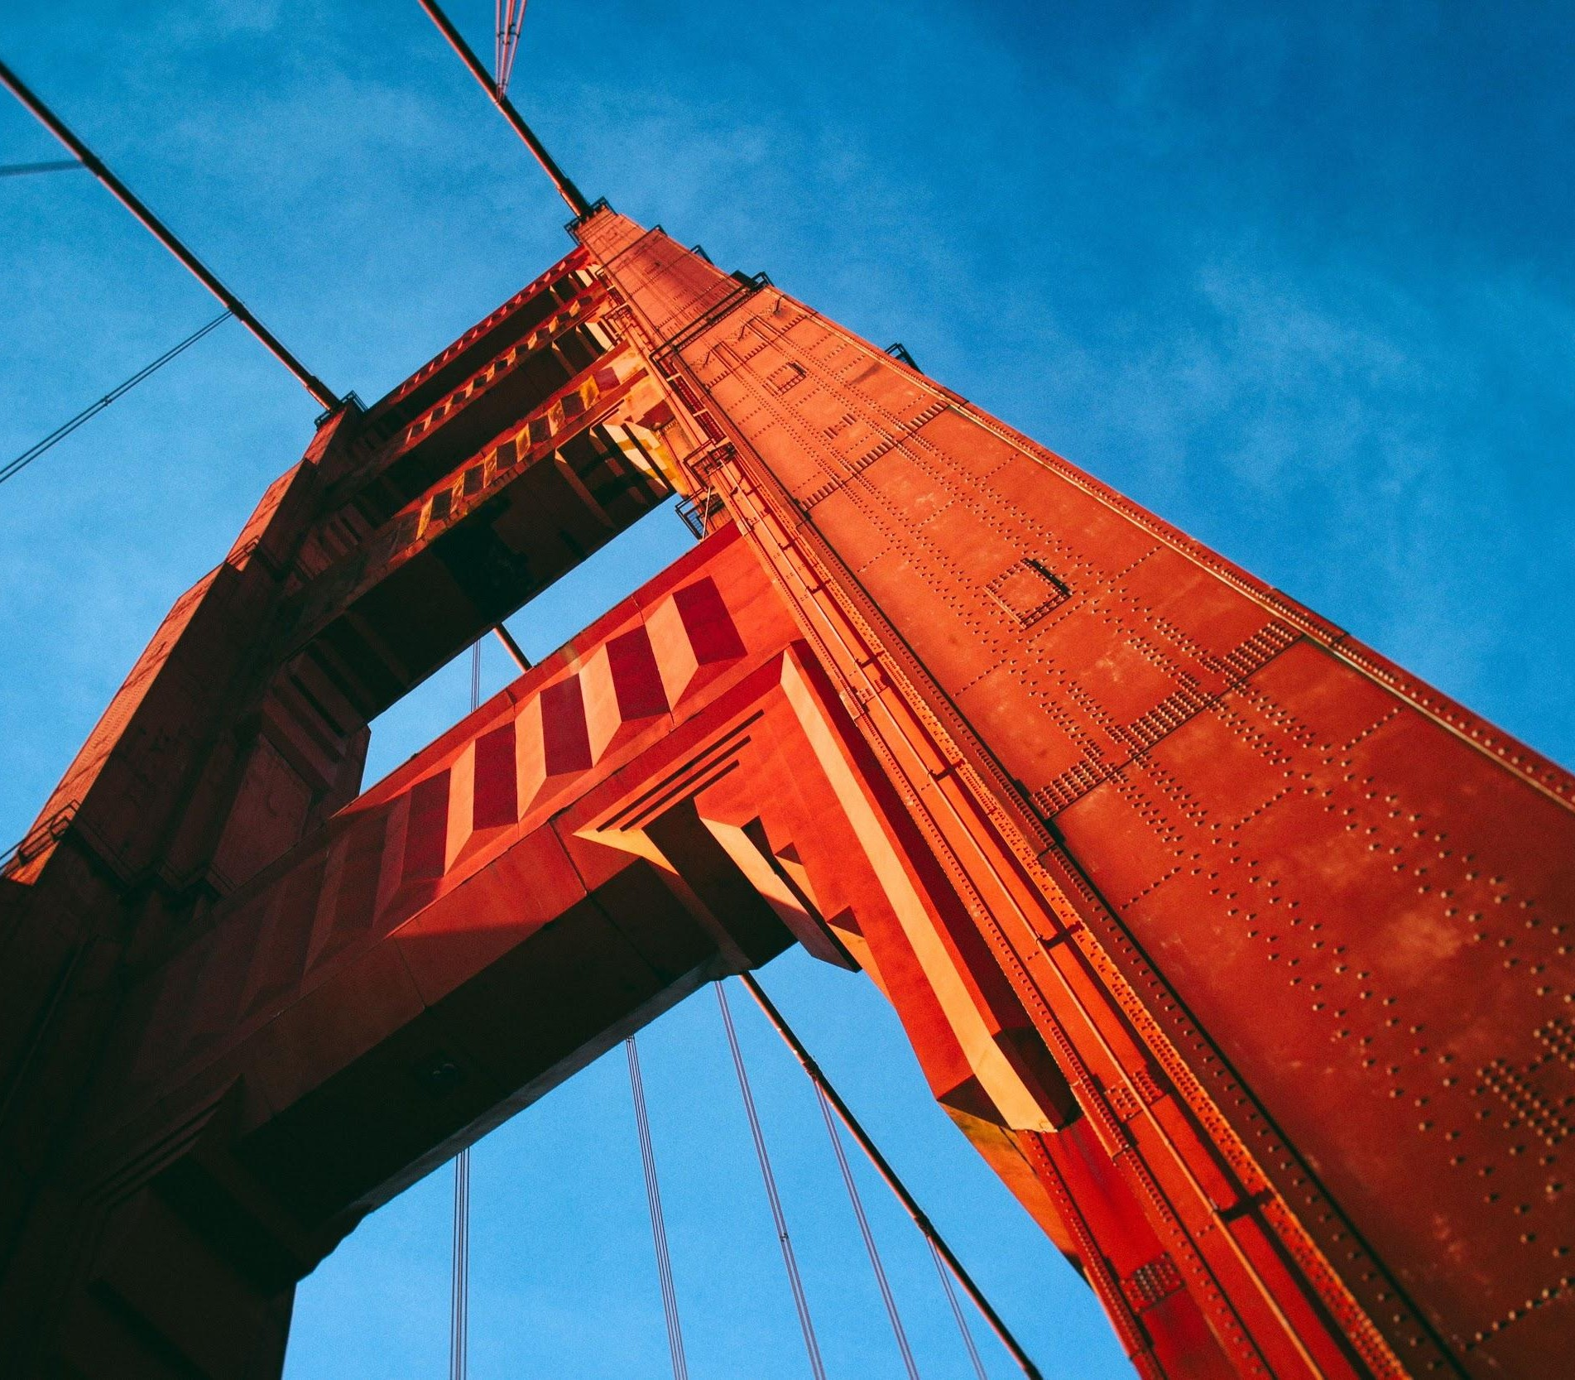
Thank You
Team Traﬃx NIT Warangal Telangana, India

